Slide 1


TOPIC: Introduction to Internet and WWW
COURSE: CCC Concept
CHAPTER: Introduction to Internet and WWW
DAY: 34
Presentation By: Shruti Dubey

Slide 2
Modes of Connected Internet
Before we dive in to how to connect to a hotspot and related security issues, let’s define what we mean. While some people use the terms “hotspot” and “mobile hotspot” interchangeably, they have distinct meanings.
Hotspot: A hotspot is a physical location where people can access the Internet, typically using W -Fi, via a wireless local area network (WLAN) with a router connected to an Internet service provider. Most people refer to these locations as “Wi-Fi hotspots” or “Wi-Fi connections.” Simply put, hotspots are the physical places where users can wirelessly connect their mobile devices, such as smartphones and tablets, to the Internet.
A hotspot can be in a private location or a public one, such as in a coffee shop, a hotel, an airport, or even an airplane. While many public hotspots offer free wireless access on an open network, others require payment. Later in the article you’ll learn how to connect a mobile device to a Wi-Fi hotspot.

Slide 3
Modes of Connected Internet
Mobile hotspot: A mobile hotspot (sometimes called a portable hotspot) is a hotspot that’s just that—mobile! While a “regular” Wi-Fi hotspot is tied to a physical location, you can create a mobile hotspot by using your smartphone’s data connection to connect your laptop to the Internet. This process is called “tethering.” More on this process later.
Access point (wireless access point): A wireless access point (WAP) is a networking device that allows a Wi-Fi compliant device to connect to a wired network. The WAP can either be physically connected to a router or be integrated into the router itself. A WAP is not a hotspot, which is the physical location where Wi-Fi access to a WLAN is available.

Slide 4
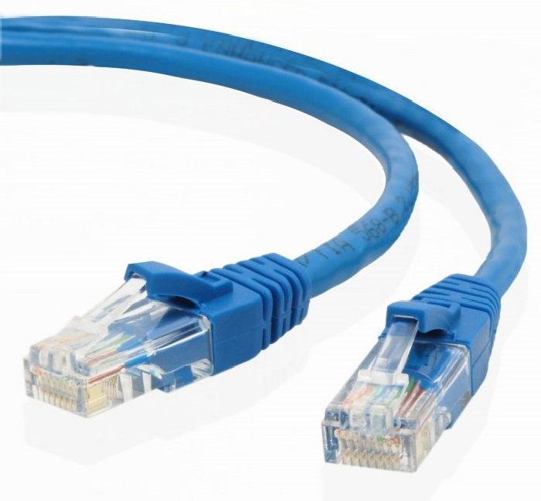
Modes of Connected Internet
LAN Cable :-
RJ45

Slide 5
Modes of Connected Internet
Broadband:-
Broadband Internet service truly is the most used form of Internet access because of its high access speeds; it is offered in four different forms, DSL (or Digital Subscriber Line), also fiber-optic, cable, and satellite. The old dial-up connection is the only non-broadband internet service available, and even though it is cheaper, most Internet users are moving towards the faster broadband Internet connection.

Slide 6
Modes of Connected Internet
USB Tethering:-
USB Tethering is a feature in your Smartphone that makes you to connect your phone to a computer via USB Cable. USB Tethering allows the sharing of an Internet connection of the phone or tablet with other device such as laptop/computer via USB Data cable.
USB Tethering does not require any driver installation in PC/Laptop while connecting it with smartphone for using packet data.
USB Tethering option will appear only when your Phone is connected with PC through USB cable.
Your mobile data should be activated in your mobile device so as to share the mobile data to your PC/Laptop.

Slide 7
Difference between MAC Address and IP Address
Both MAC Address and IP Address are used to uniquely defines a device on the internet. NIC Card’s Manufacturer provides the MAC Address, on the other hand Internet Service Provider provides IP Address.
The main difference between MAC and IP address is that, MAC Address is used to ensure the physical address of computer. It uniquely identifies the devices on a network. While IP address are used to uniquely identifies the connection of network with that device take part in a network.

Slide 8
Difference between MAC Address and IP Address
S.NO MAC ADDRESS IP ADDRESS
1.
MAC Address stands for Media Access Control Address.
IP Address stands for Internet Protocol Address.
2.
MAC Address is a six byte hexadecimal address.
IP Address is either four byte (IPv4) or six byte (IPv6) address.
3.
A device attached with MAC Address can retrieve by ARP protocol.
A device attached with IP Address can retrieve by RARP protocol.
4.
NIC Card’s Manufacturer provides the MAC Address.
Internet Service Provider provides IP Address.
5.
MAC Address is used to ensure the physical address of computer.
IP Address is the logical address of the computer.
6.
MAC Address operates in the data link layer.
IP Address operates in the network layer.
7.
MAC Address helps in simply identifying the device.
IP Address identifies the connection of the device on the network.
8.
MAC Address of computer cannot be changed with time and environment.
IP Address modifies with the time and environment.
9.
MAC Address can’t be found easily by third party.
IP Address can be found by third party.

Slide 9
What is Web Browsers
“A web browser (commonly referred to as a browser) is a software application for retrieving, presenting and traversing information resources on the World Wide Web. An information resource is identified by a Uniform Resource Identifier (URI/URL) and maybe a web page, image, video or other pieces of content. Hyperlinks present in resources enable users easily to navigate their browsers to related resources.”
In simple words, Web Browser is a Computer Application which allows the user to connect with the internet to access web pages, videos, images or other information.

Slide 10
Popular Web Browsers
Chrome
Firefox
IE
Safari
Edge
Opera
UC Browser
Yandex Browser
Coc Coc
Others – Chromium, Maxthon, Vivaldi

Slide 11
Useful Resources
www.nielit.gov.in/econtent
www.wikipedea.org
www.computerhope.com
www.tutorviacomputer.com

Slide 12
Thank you!
www.nielit.gov.in/haridwar

